Slide 1
Tree Data Structure
Dr. Naveen Kumar
Associate Professor
Amity Institute of Information Technology
Amity University Patna

Slide 2
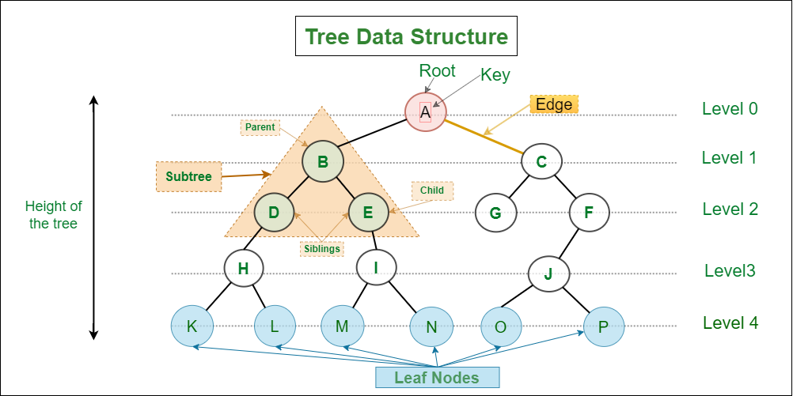

Slide 3
Types of Tree Data Structures
Tree data structures can be classified based on the number of children each node can have.
Binary Tree:
Each node can have a maximum of two children.
Full Binary Tree – every node has either 0 or 2 children.
Complete Binary Tree – all levels are fully filled except possibly the last, which is filled from left to right.
Balanced Binary Tree – height difference between left and right subtrees of every node is minimal.

Slide 4
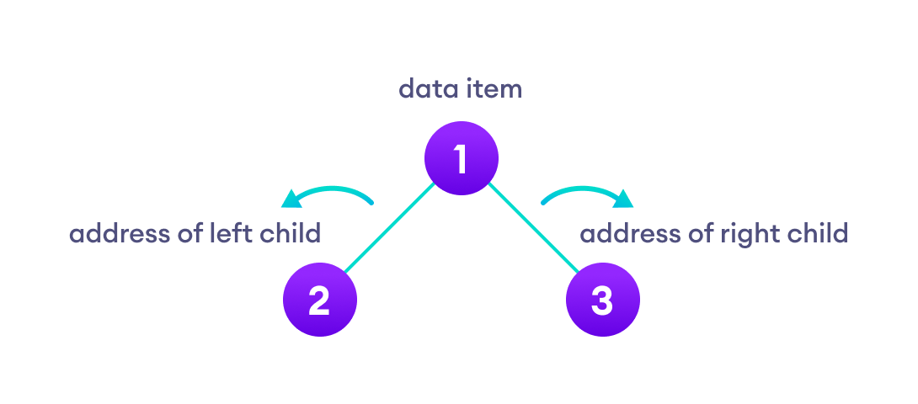

Binary Tree
A binary tree is a tree data structure in which each parent node can have at most two children.
Each node of a binary tree consists of three items:
data item
address of left child
address of right child

Slide 5
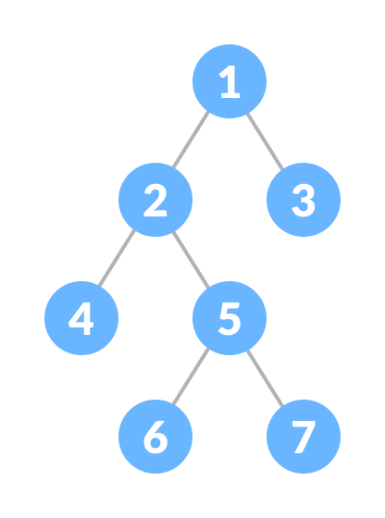
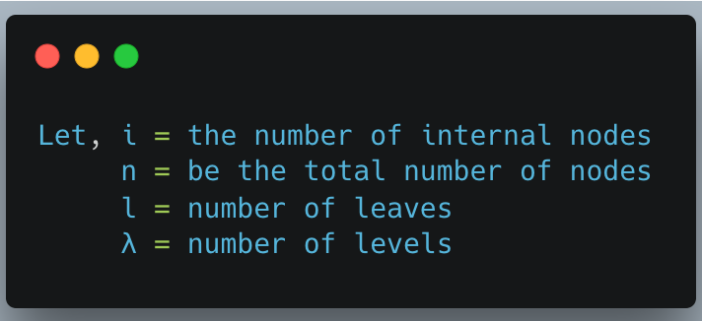
Types of Binary Tree
1. Full Binary Tree
A full Binary tree is a special type of binary tree in which every parent node/internal node has either two or no children.
It is also known as a proper binary tree.

Slide 6
Full Binary Tree Theorems
The number of leaves is i + 1.
The total number of nodes is 2i + 1.
The number of internal nodes is (n – 1) / 2.
The number of leaves is (n + 1) / 2.
The total number of nodes is 2l – 1.
The number of internal nodes is l – 1.
The number of leaves is at most 2^{λ - 1}.

Slide 7
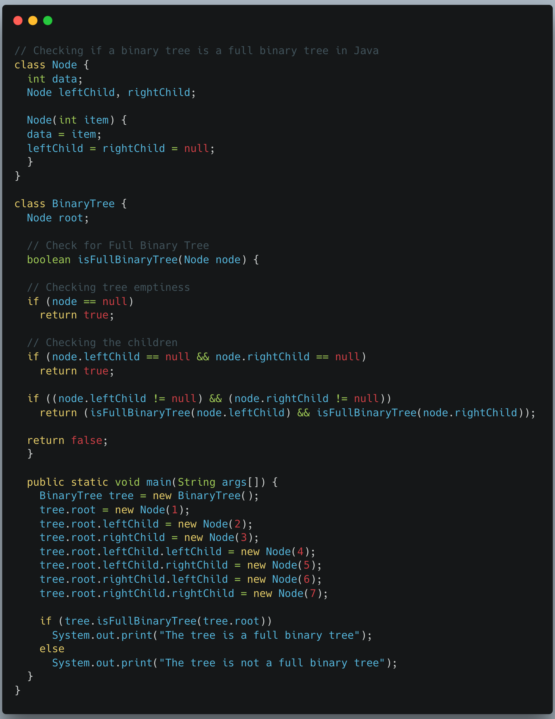

Slide 8
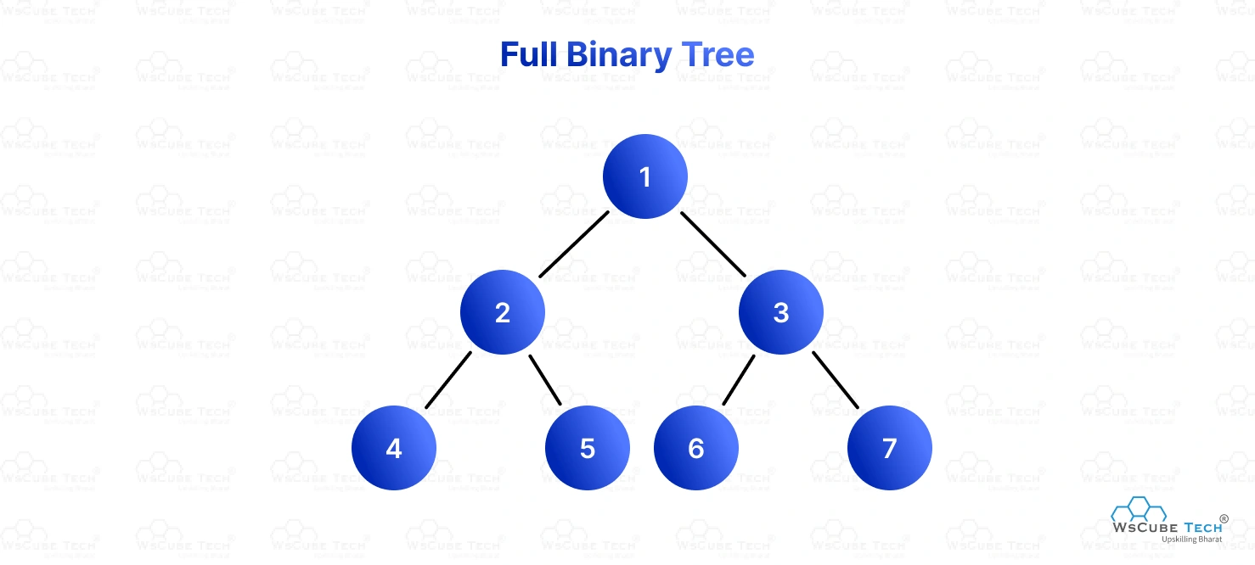
A full binary tree is a tree where every node has either 0 or 2 children.

Slide 9
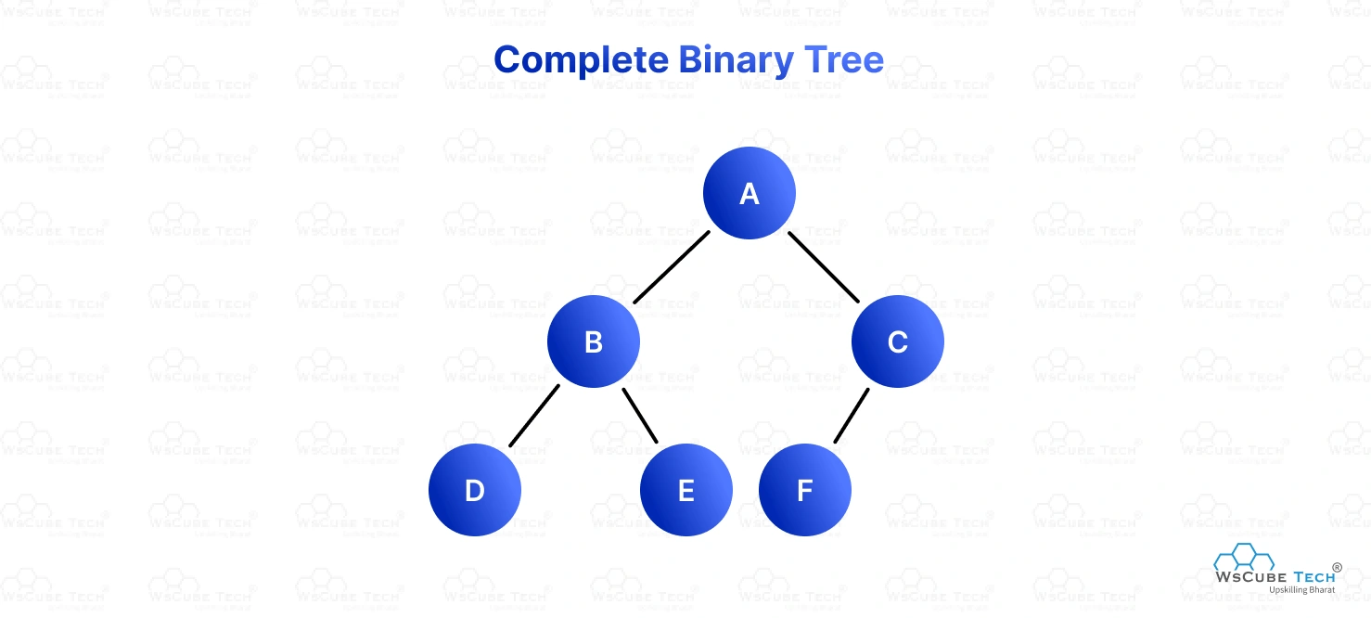
A complete binary tree is a tree where all levels are fully filled except possibly the last level, which is filled from left to right.

Slide 10
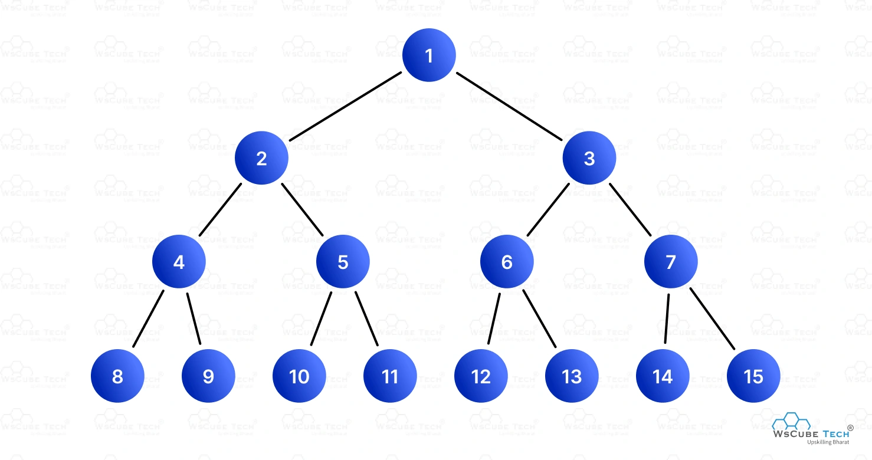
A perfect binary tree is a tree where all internal nodes have exactly two children and all leaf nodes are at the same level.

Slide 11
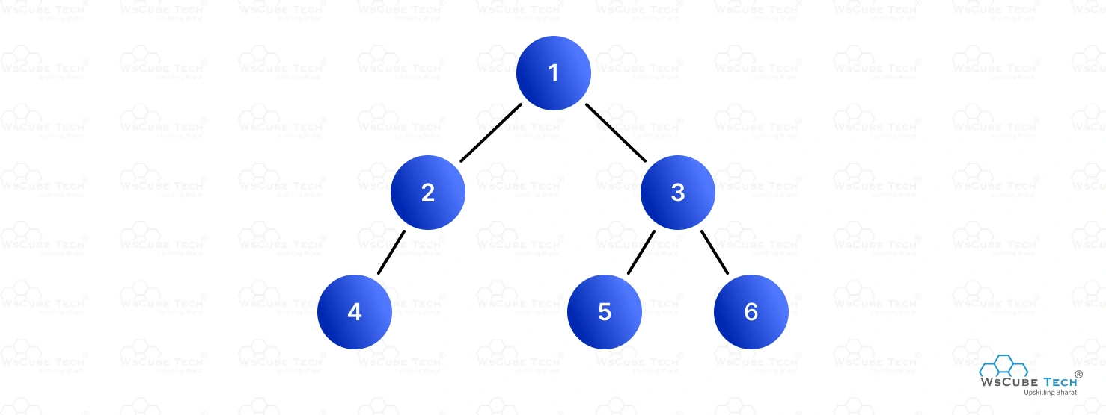
A balanced binary tree is a tree where the height of the left and right subtrees of any node differ by at most one.

Slide 12
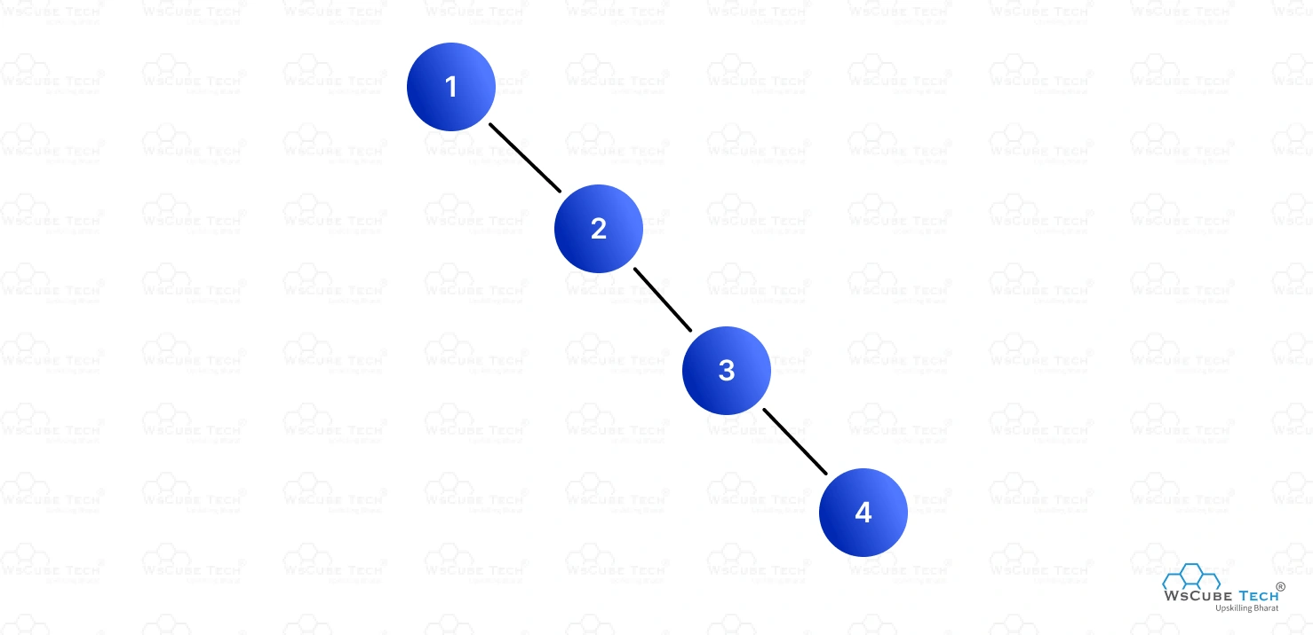
Degenerate (or Pathological) A degenerate binary tree is a tree where each parent node has only one child. This makes the tree look like a linked list.

Slide 13
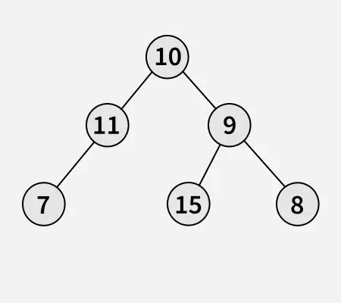
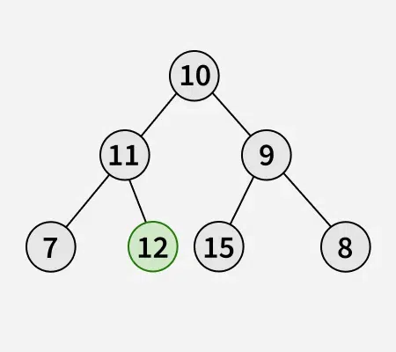
Insertion in a Binary Tree in level order

Slide 14
Insert Algorithm in General Binary Tree
Iterate level order traversal of the given tree using queue.
If we find a node whose left child is empty, we make a new key as the left child of the node.
Else if we find a node whose right child is empty, we make the new key as the right child.
We keep traversing the tree until we find a node whose either left or right child is empty.

Slide 15
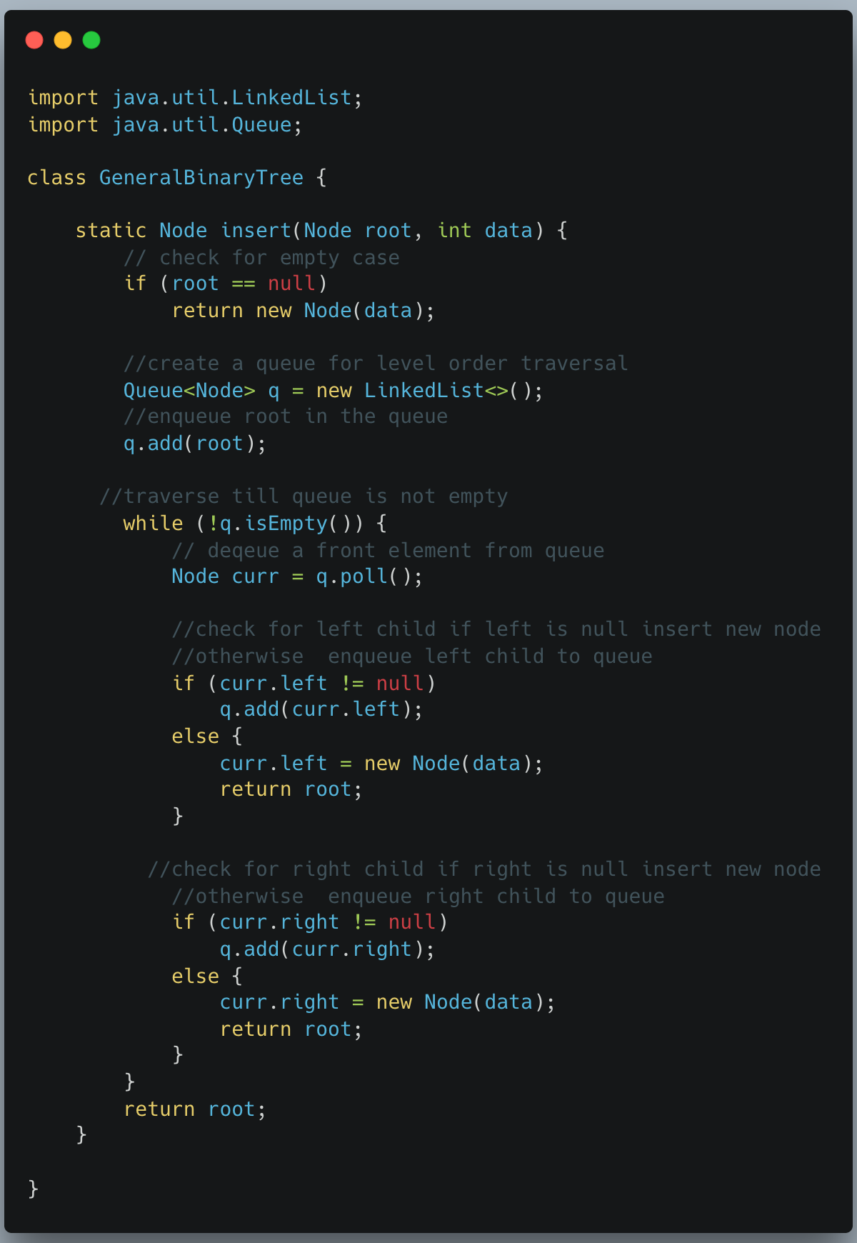

Slide 16
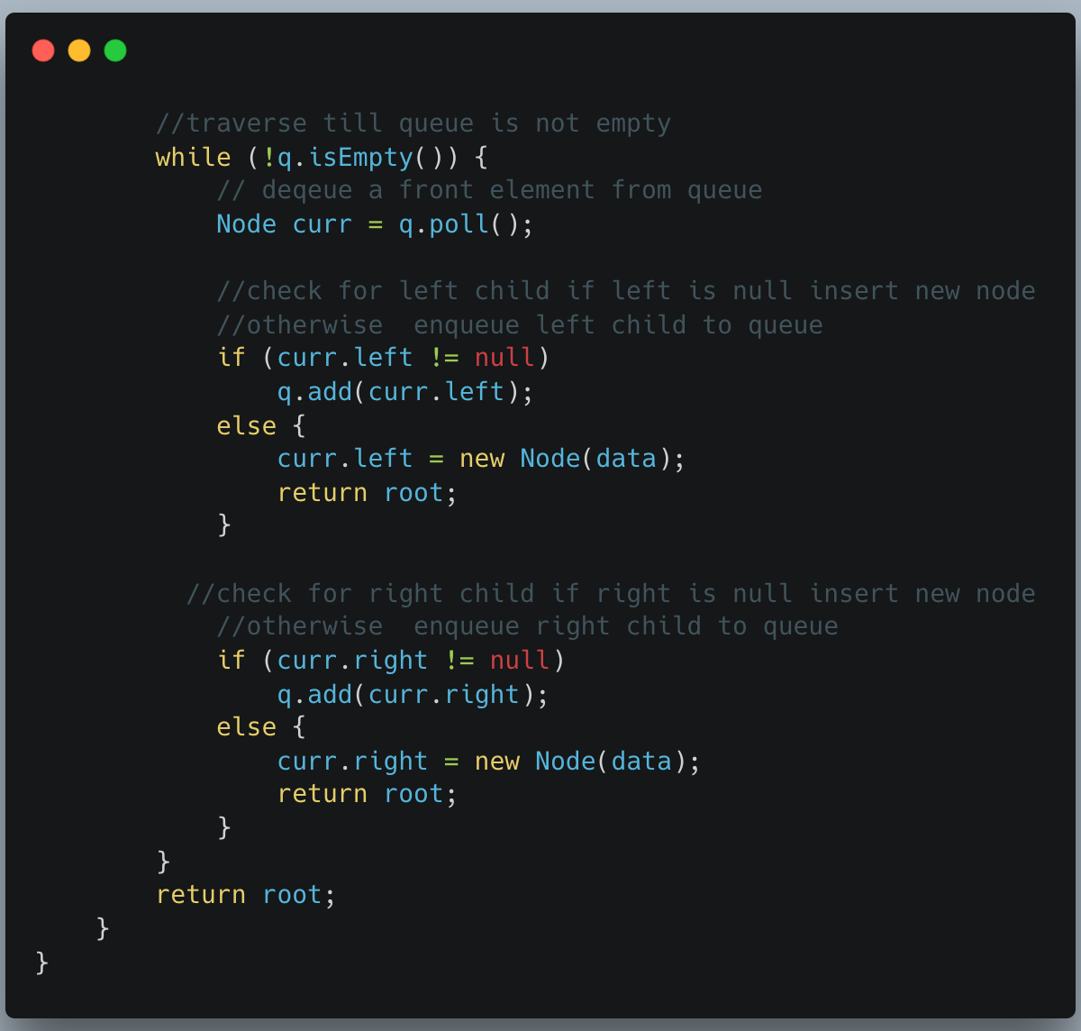
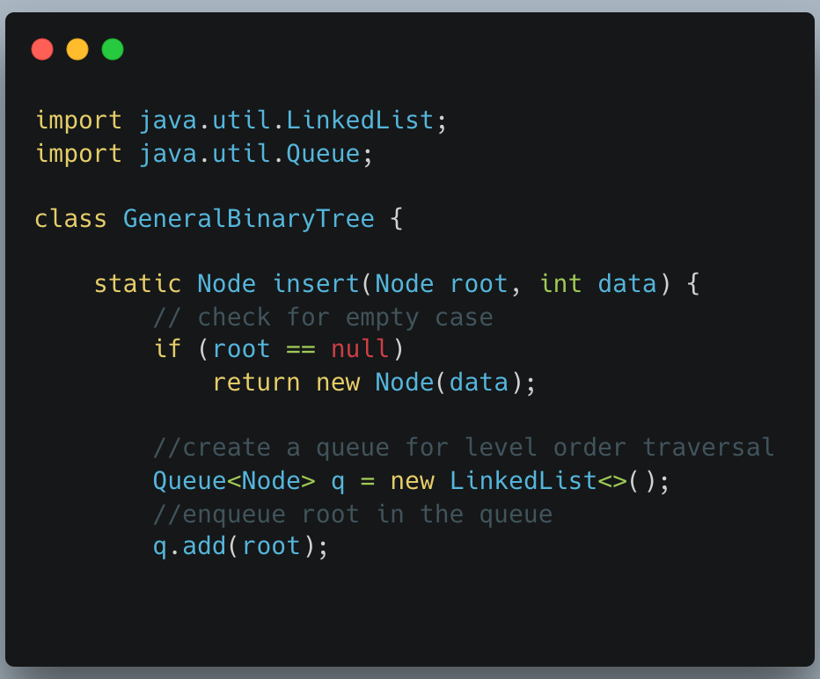

Slide 17
Delete Operation in General Binary Trees
For a general binary tree, the deletion process is simpler and aims to maintain the tree's structure rather than key order.
Find the node to be deleted.
Find the deepest and rightmost node in the entire tree.
Replace the data of the node to be deleted with the data of the deepest and rightmost node.
Remove the deepest and rightmost node from its original position.
This approach ensures the tree "shrinks from the bottom," which helps in maintaining the overall balance, though it has a time complexity of O(n) in the worst case because the entire tree may need to be traversed to find the deepest node.

Slide 18
The idea is to traverse the tree in level order manner.
To perform the Deletion in a Binary Tree follow below:
Starting at the root, find the deepest and rightmost node in the binary tree and the node which we want to delete.
Replace the deepest rightmost node’s data with the node to be deleted.
Then delete the deepest rightmost node.

Slide 19
